Slide 3
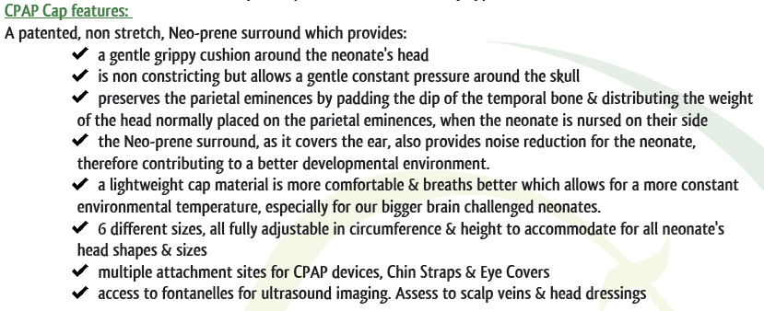
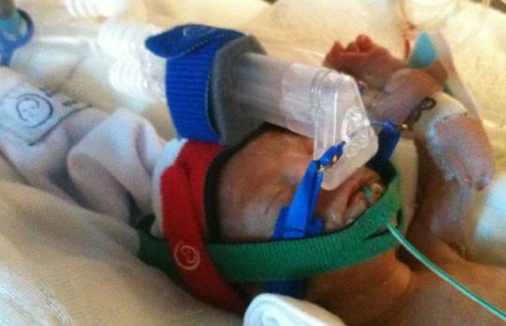

Slide 4
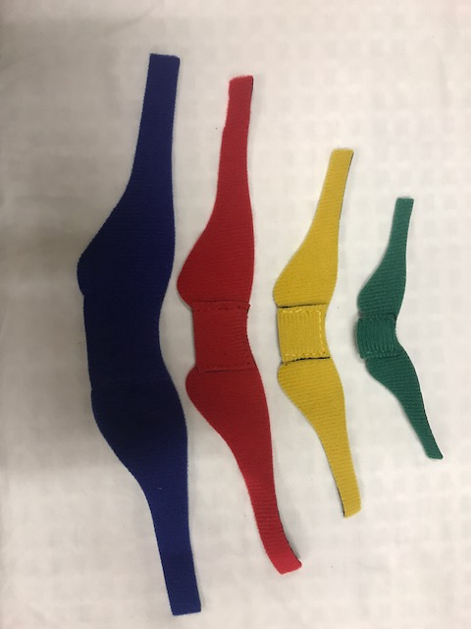
colour coded sizes XS, S, M, L.

Slide 5
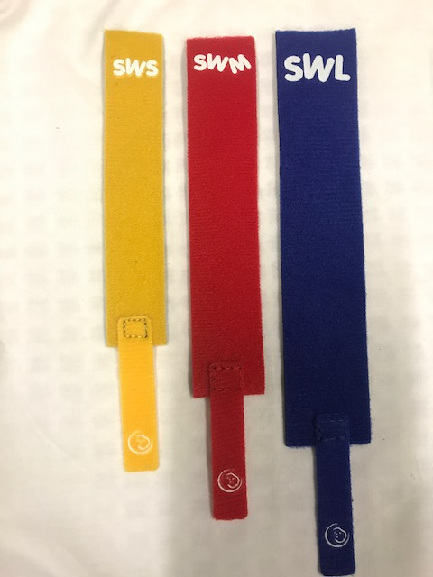
colour coded sizes S, M, L.

Slide 6
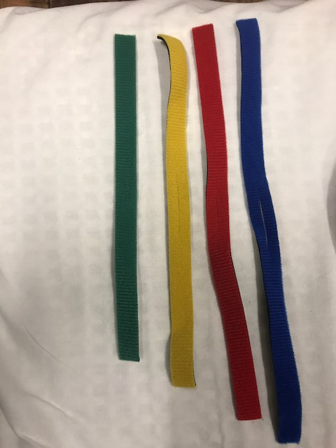
Chin Strap features:
a soft, comfortable strap to hold chin gently, mouth shut, to avoid ‘pop off’
attaches to NEO-prene rim of cap, for ease of use
colour coded sizes from XS, S, M, L
NB new thicker chin straps are being introduced. The thicker side goes under the chin. Do NOT use too much pressure to secure. If oedema is present, do not use.

Slide 7
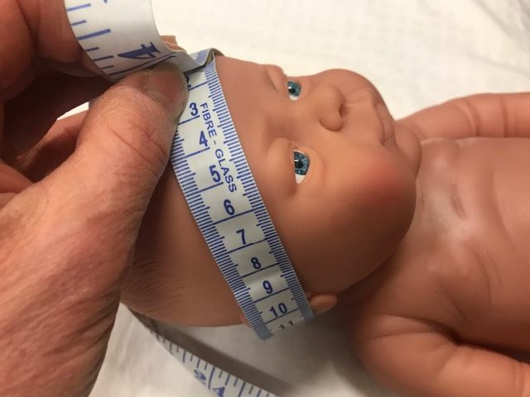
Application Instructions
Assess cap size required. Cap head circumference measurement is taken from nape of neck (hairline), across the ears, to the middle of the forehead. Standard head circumference is comparable unless there is moulding or head asymmetry. So, best to measure cap head circumference for initial application, at birth.

Slide 8
Application Instructions
Choose appropriately sized cap. Each cap comes in 5cm increments. Starting at <25cm to 50cm.
Each cap size has a colour coded NEO-prene rim.
Green = XSmall = <25cm
Yellow = Small = 25-30cm
Red = Medium = 30-35cm
Blue = Large = 25-40cm
Black = XLarge = 40-45cm
White = XXLarge = 45/50cm

Slide 9
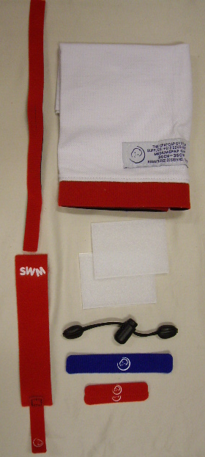
Application Instructions
Each package contains:
Cotton cap with NEO-prene rim
Chin strap
Self adhesive hook fastener
Shock cord tightener
Swap wrap
Short double sided fasteners
Eye covers
Snorkel Grip

Slide 10
Application Instructions
1) Place the middle of the coloured cap rim under the back (nape) of neck, then wrap rim over the ears & across the forehead.

Slide 11
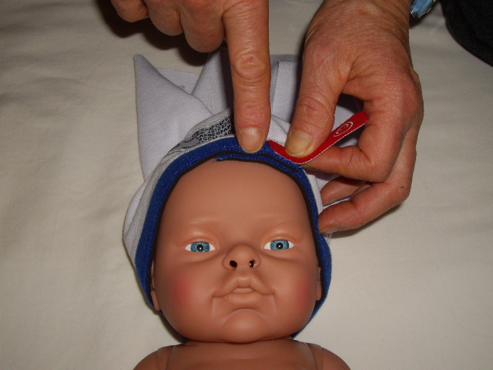
Application Instructions
2) Ensure there is some overlap of the cap rim, where it joins. No overlap means the cap is too small. So, use the next size up. Vary the overlap site, with cares.

Slide 12
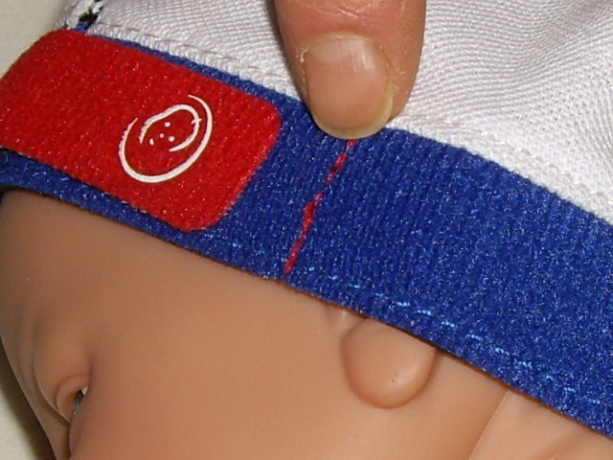
Application Instructions
3) Secure cap with hook tab, onto coloured loop rim of cap. Have a snug but NOT tight fit. If tab crosses stitched line on rim, use a smaller cap.

Slide 13
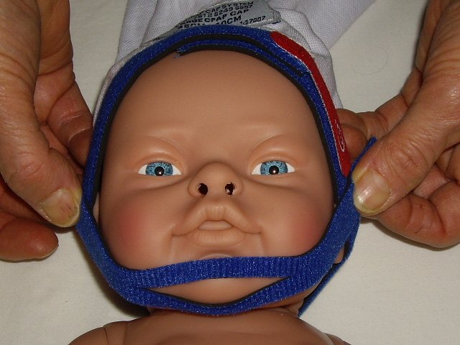
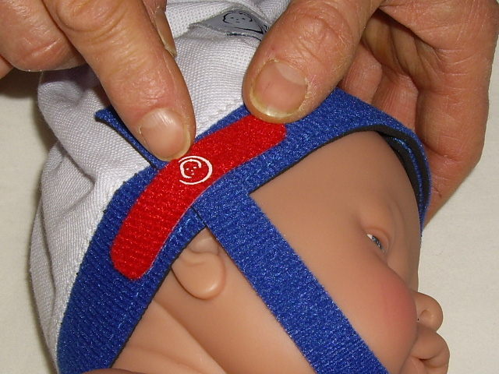
Application Instructions
4) Place the chin inside Chin Strap slit, to gently hold the mouth shut. Feeding tubes can be threaded through the slit.
Attach to the Neo- prene rim of cap with the two 13mm x 60mm small fasteners, either side.
NB: this step can be done at any time.
NB new thicker chin straps are being introduced. The thicker side goes under the chin. Do NOT use too much pressure to secure. If oedema is present, do not use.

Slide 14
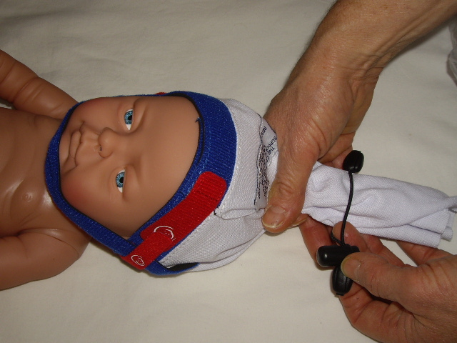
Application Instructions
5) Gather top of cap together & feed into SCT, move SCT down to top of the head, creating an even & snug fitting cap, as close to scalp as possible.
NB: some like to twist the cotton top, a little, to help gather evenly.

Slide 15
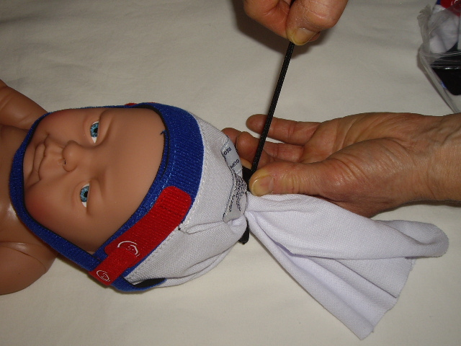
Application Instructions
6) TIGHTEN SCT FIRMLY. It is essential that cap material does not slip through SCT. As this stops the Cpap device from moving, once secured.

Slide 16
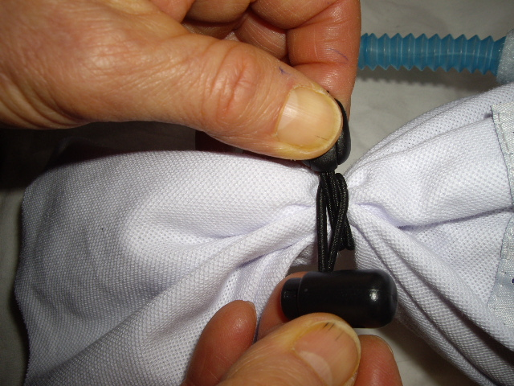
Application Instructions
7) If a brain monitor or scalp vein are present, & the wires/tubes can't be threaded through SCT. Then, tighten SCT around the wires/tubes, as illustrated. Remove SCT, to access fontanelle, for ultrasound.

Slide 17
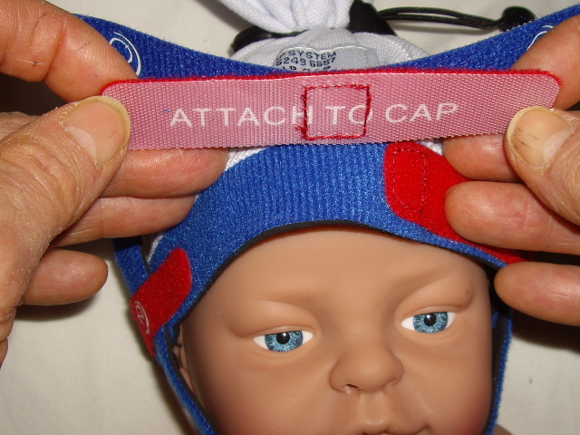
Application Instructions
8) Identify Snorkel Grip (SG) ‘ATTACH TO CAP’, attach this side of SG to the rim of cap by positioning the stitched square exactly in the midline above the baby’s nares.

Slide 18
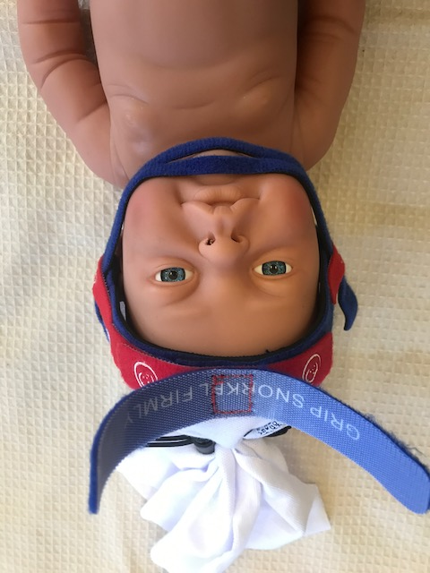
Application Instructions
This allows the midline interface, when applied, to line up ‘square’ with the nares. So that the prongs do not apply more pressure on one nare from the prongs being off centre.

Slide 19
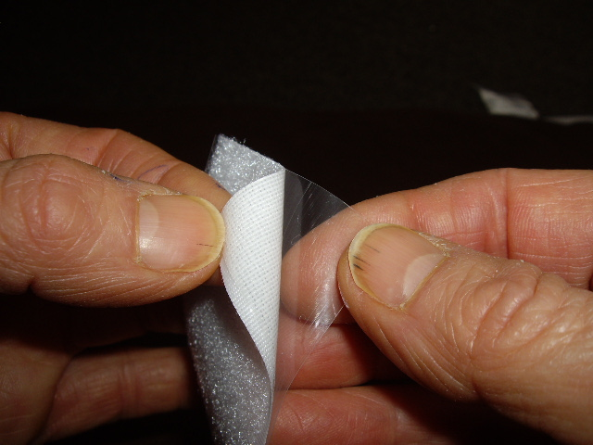
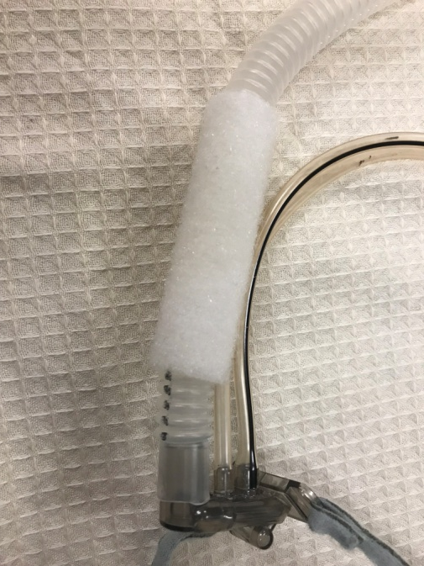
Application Instructions
9) Remove backing from self adhesive wraps. Place one, lengthwise, around the corrugated Cpap tubing, ensuring it is above the pop off slit

Slide 20
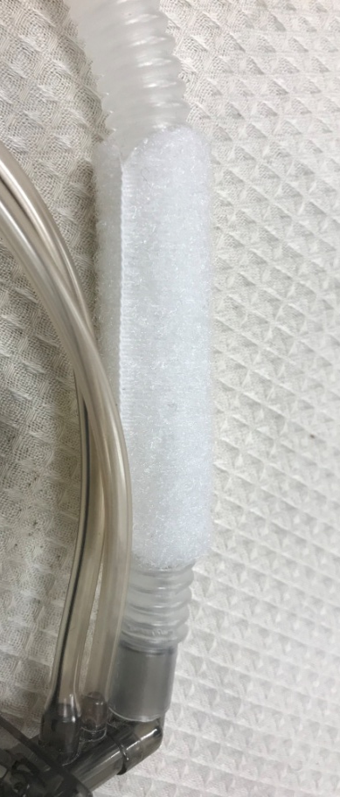
Application Instructions
Also, it’s better if the join is closest to the neonates head, as it will adhere longer, with less stress on the join, when readjusting tubing. There is a spare self adhesive wrap, to replace old wraps if adhesion weakens, & wrap lifts. Store spare in bag under cot.

Slide 21
Application Instructions
9) Gently position prongs into neonate's nares, as per manufacturer's instructions.
Then, place the midline interface, where the self adhesive is, in the centre of the SG.

Slide 22
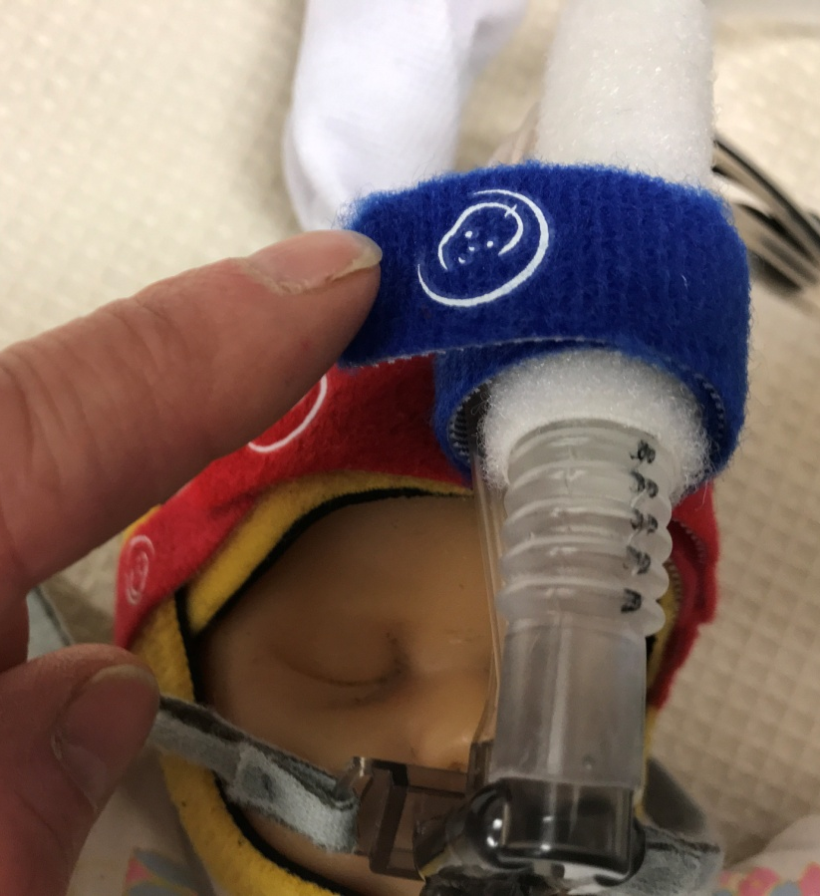
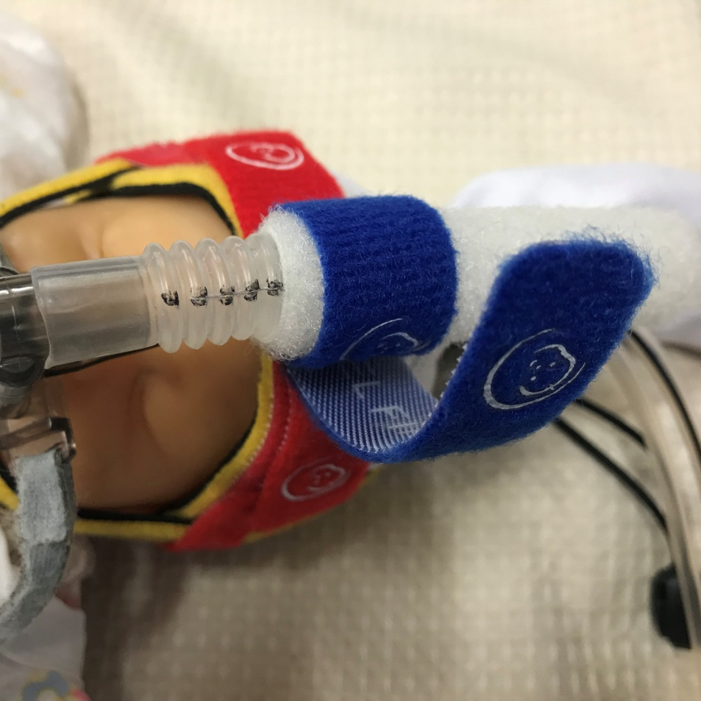
Application Instructions
Wrap each SG arm securely around the midline interface, to hold in place.

Slide 23
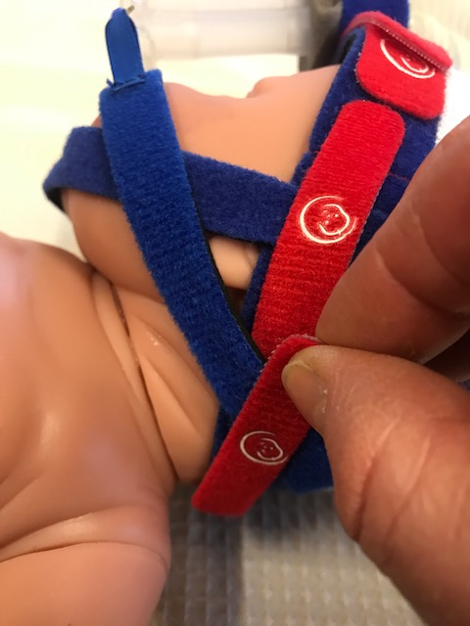
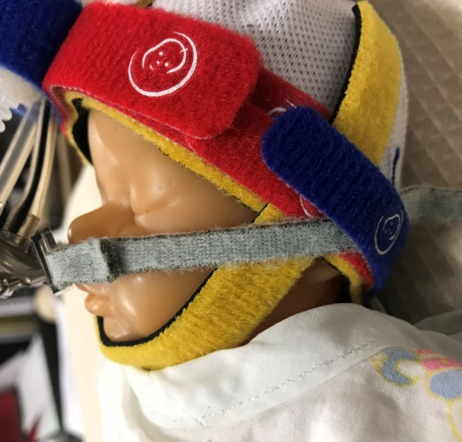
Application Instructions
11) Ensure prongs are still evenly positioned in neonate’s nares. With either Midline Anchors (MLA) or the interface’s grey straps in place, on each side of interface, direct each MLA towards the nape of the neck each side. This avoids pressure around the eyes. Secure each MLA to the rim of cap with a small double sided fastener.

Slide 24
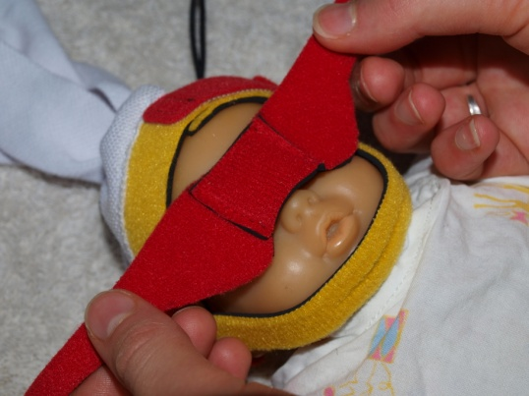
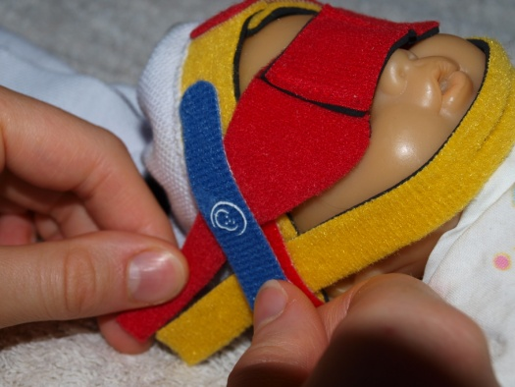
Application Instructions
12) Optional: Place the Eye Covers over the neonate's eyes if they are requiring phototherapy; if they require a procedure under bright lights; or if it is part of the neonates developmental plan to have less visual stimulation, especially at night. Ensure there is no light access to the neonates eyes, move the cover's arms up or down to allow the EC to lay flat with no gaps. Secure the Eye Covers with the double sided fastener.

Slide 25
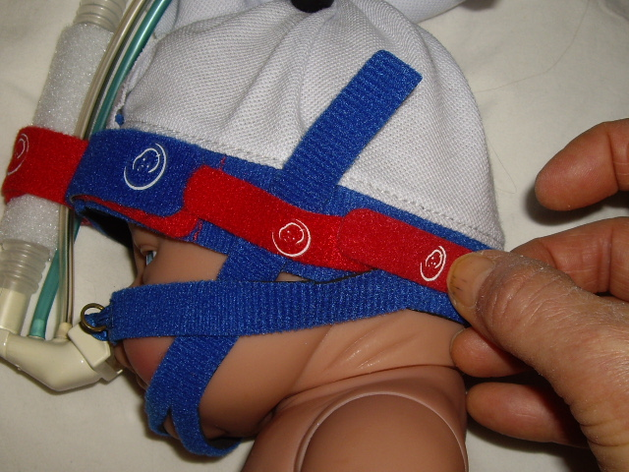
Application Instructions
NB: ALL FASTENERS ARE DOUBLE SIDED, SO THEY CAN BE USED ON THE SAME OR OVERLAPPING RIM SITES.
Short fasteners overlapping.
Fasteners also have logo in the middle, place this over the accessory being fastened, which allows for equal sided & therefore more secure anchorage.

Slide 26
Application Instructions
NB: CAP MUST BE RELEASED EVERY 4-6 HOURS TO STOP DEFORMITIES OCCURRING FROM RAPIDLY GROWING HEADS.
WHEN THERE IS NO OVERLAP, MOVE TO NEXT LARGER SIZED CAP.
EACH CAP HAS 5CMS OF GROWTH.

Slide 27
Application Instructions
13) Use Sat Wrap instead of self adhesive bandage, to secure Saturation probe. To lessen possible pressure burns, as well as stop ambient light & constriction (pressure), which can interfere with accurate probe readings.

Slide 28
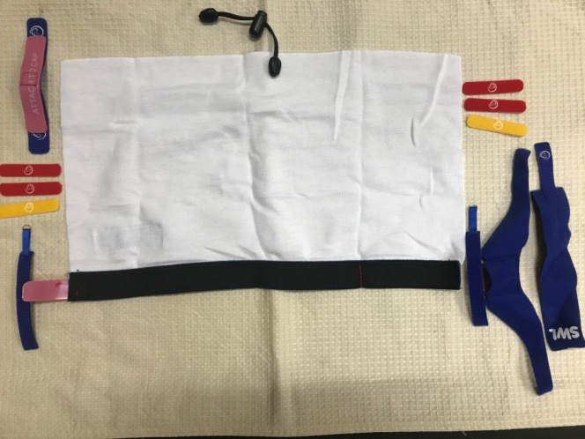
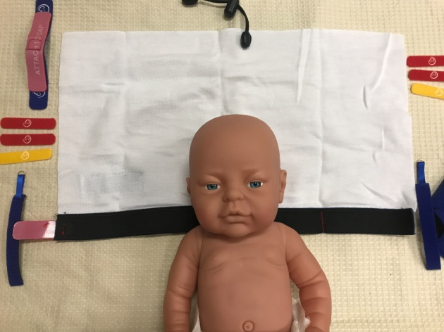
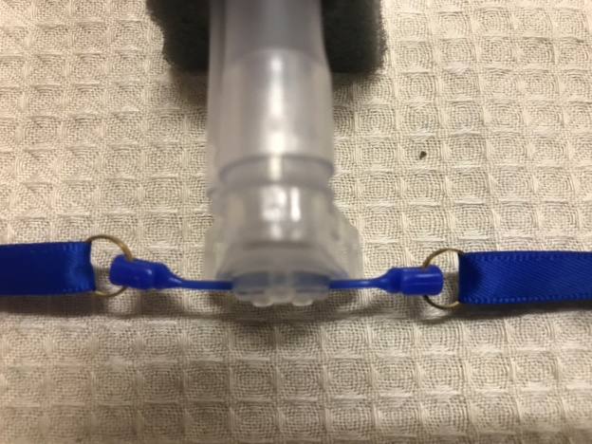
Handy tips
If you know the size of cap required, unpack & separate all accessories, so they are all ready for quick application.
When receiving a new admission, lay cap open on mattress, at head height, ready to receive neonate & apply CPAP promptly.
If you know the size of the Cpap interface required, you can fit midline anchors or grey straps onto interface prior to receiving neonate, if you wish. So, again, CPAP can be applied as soon as neonate is received & cap is fitted.

Slide 29
Washing Instructions
One baby use
If cap becomes soiled, follow AS/NZS 4146:2000, as follows:
3.5.2 Thermal
Soiled linen that is to be thermally disinfected shall be washed so that the temperature of the load is maintained at a minimum of 65°C for not less than 10 minutes.
As it will take time for heat to penetrate the load, an allowance for mixing time and load level shall be made to ensure that the load is maintained at the correct temperature for the minimum time period. For low loading 4 minutes shall be allowed, and for high loading 8 minutes. The minimum time/temperature combinations are therefore—
Summary: 65°C maintained for not less than 10 minutes; minimum cycle time 14 minutes for low loading or 18 minutes for high loading.

Slide 30
Notice
The NEO-prene Cpap Cap System has been designed & is distributed by Austranter Medical Pty Ltd.
Patent No. 2014101151
Registered Design: No. 147007

