Slide 3
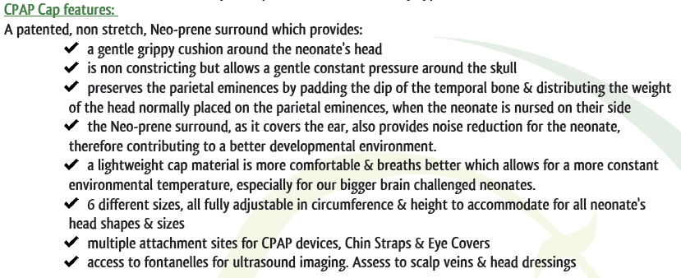
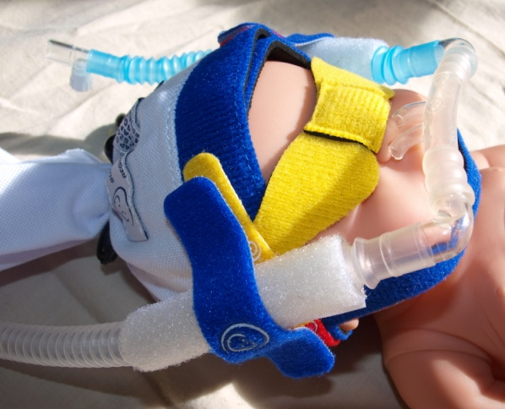

Slide 4
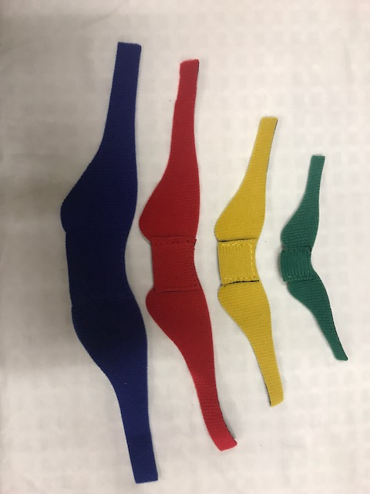
colour coded sizes XS, S, M, L.

Slide 5
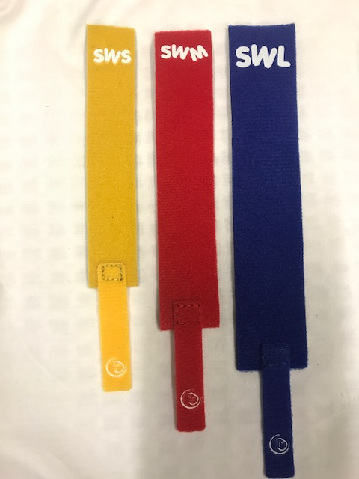
colour coded sizes S, M, L.

Slide 6
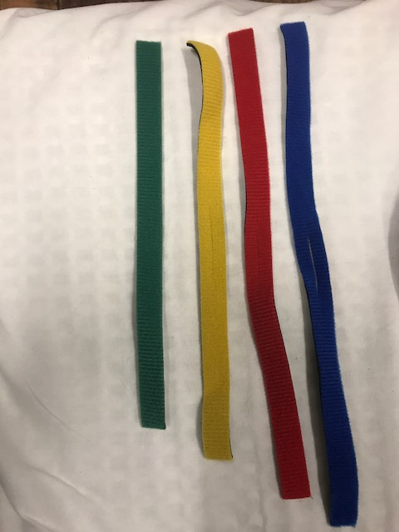
Chin Strap features:
a soft, comfortable strap to hold chin gently, mouth shut, to avoid ‘pop off’
attaches to NEO-prene rim of cap, for ease of use
colour coded sizes from XS, S, M, L

Slide 7
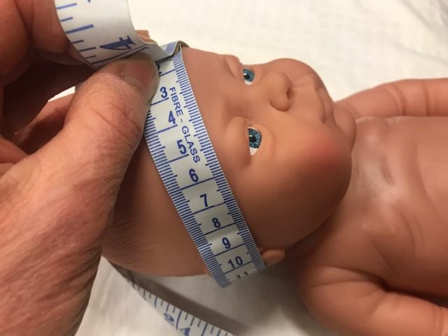
Application Instructions
Assess cap size required. Cap head circumference measurement is taken from nape of neck (hairline), across the ears, to the middle of the forehead. Standard head circumference is comparable unless there is moulding or head asymmetry. So, best to measure cap head circumference for initial application, at birth.

Slide 8
Application Instructions
Choose appropriately sized cap. Each cap comes in 5cm increments. Starting at <25cm to 50cm.
Each cap size has a colour coded NEO-prene rim.
Green = XSmall = <25cm
Yellow = Small = 25-30cm
Red = Medium = 30-35cm
Blue = Large = 25-40cm
Black = XLarge = 40-45cm
White = XXLarge = 45/50cm

Slide 9
Application Instructions
Each package contains:
Cotton cap with NEO-prene rim
Chin strap
Long double sided fasteners x 2
Short double sided fasteners x 2
Shock cord tightener
Self adhesive loop wraps x 4
Swap wrap
Short double sided fasteners x 2
Eye covers

Slide 10
Application Instructions
1) Place the middle of the coloured cap rim under the back (nape) of neck, then wrap rim over the ears & across the forehead.

Slide 11
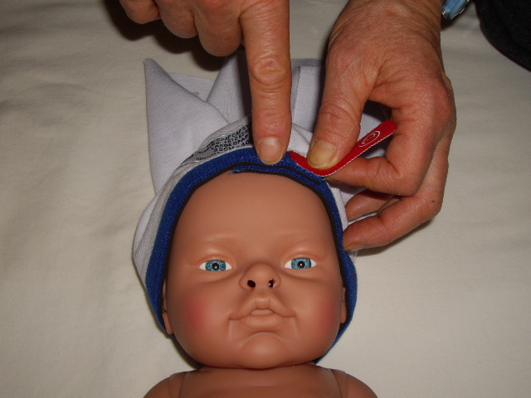
Application Instructions
2) Ensure there is some overlap of the cap rim, where it joins. No overlap means the cap is too small. So, use the next size up. Vary the overlap site, with cares.

Slide 12
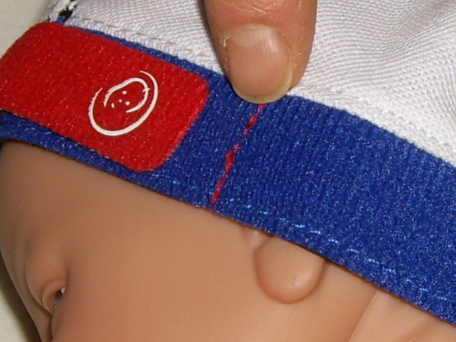
Application Instructions
3) Secure cap with hook tab (red), onto coloured loop rim of cap. Have a snug but NOT tight fit. If tab crosses stitched line on rim, use a smaller cap.

Slide 13
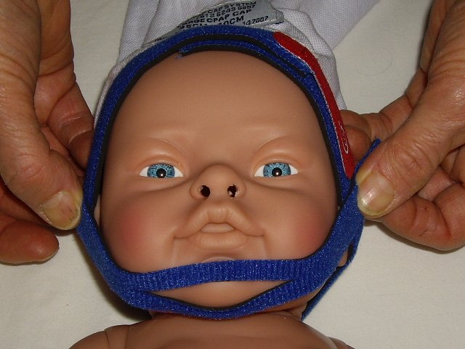
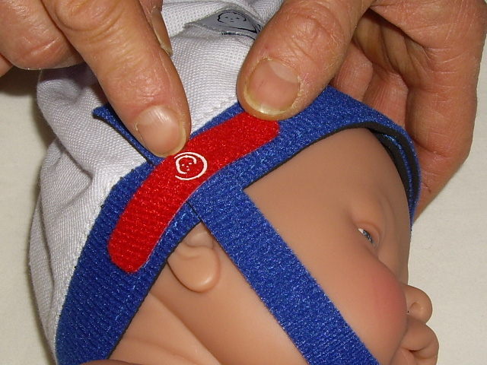
Application Instructions
4) Place the chin inside Chin Strap slit, to gently hold the mouth shut. Feeding tubes can be threaded through the slit. Attach to the Neo- prene rim of cap with the two 13mm x 60mm small fasteners, either side.
NB: this step can be done at any time.

Slide 14
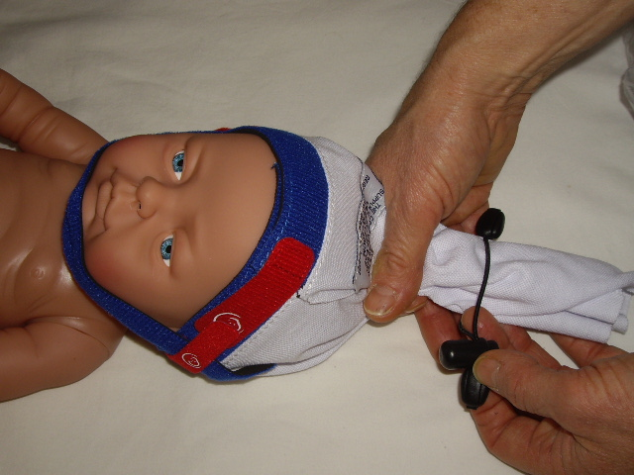
Application Instructions
5) Gather top of cap together & feed into SCT, move SCT down to top of the head, creating an even & snug fitting cap, as close to scalp as possible.
NB: some find it easier to gently twist the cotton top to gather evenly.

Slide 15
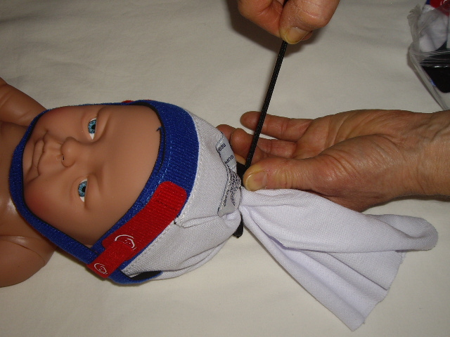
Application Instructions
6) TIGHTEN SCT FIRMLY. It is essential that cap material does not slip through SCT. As this stops the Cpap device from moving, once secured.

Slide 16
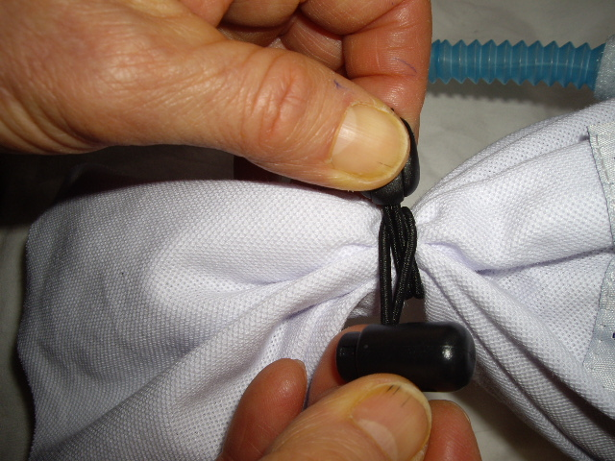
Application Instructions
7) If a brain monitor or scalp vein are present, & the wires/tubes can't be threaded through SCT. Then, tighten SCT around the wires/tubes, as illustrated. Remove SCT, to access fontanelle, for ultrasound.

Slide 17
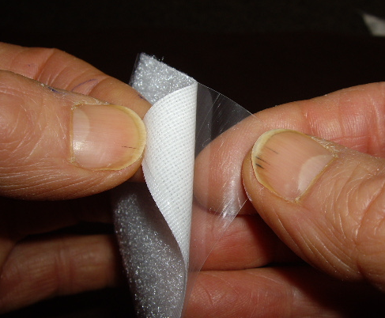
Application Instructions
8) Remove backing from self adhesive wraps. Place one, lengthwise, around each corrugated Cpap tubing

Slide 18
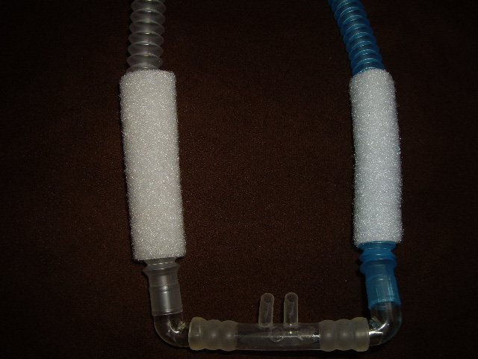
Application Instructions
It’s better if the join is closest to the neonates head, as it will adhere longer, with less stress on the join when readjusting tubing.

Slide 19
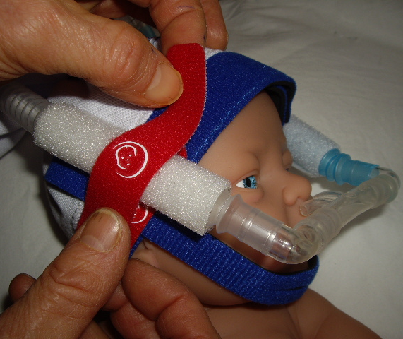
Application Instructions
9) Gently position prongs into neonate's nares, as per manufacturer's instructions. Then, secure corrugated Cpap tubing in place with long double sided fasteners (19mm x 100mm),on both sides of the head. Using the hooks on the fastener to attach to the loops of the cap rim & self adhesive tube wraps. If not sitting correctly, easily reposition, as necessary.

Slide 20
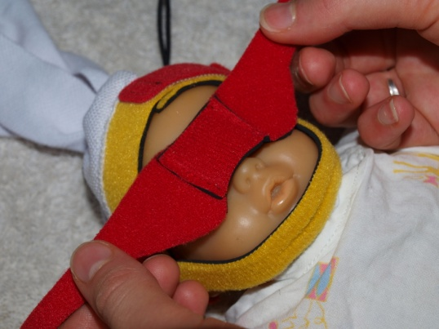
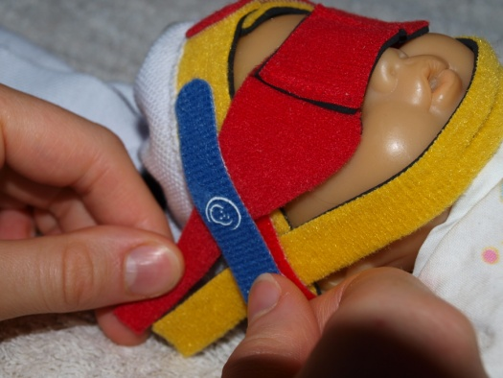
Application Instructions
10) Optional: Place the Eye Covers over the neonate's eyes if they are requiring phototherapy; if they require a procedure under bright lights; or if it is part of the neonates developmental plan to have less visual stimulation, especially at night. Ensure there is no light access to the neonates eyes, move the cover's arms up or down to allow the Eye Cover to lay flat with no gaps. Secure the Eye Covers with the double sided fastener.

Slide 21
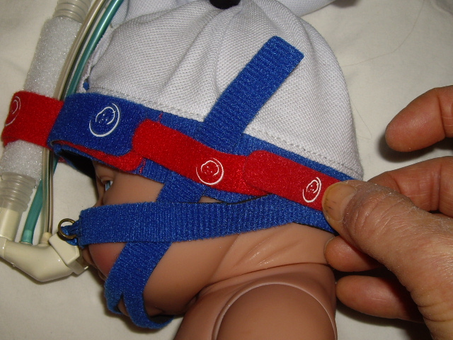
Application Instructions
NB: ALL FASTENERS ARE DOUBLE SIDED, SO THEY CAN BE USED ON THE SAME OR OVERLAPPING RIM SITES. Eg: short fasteners overlapping

Slide 22
Application Instructions
NB: CAP MUST BE RELEASED EVERY 4-6 HOURS TO STOP DEFORMITIES OCCURRING FROM RAPIDLY GROWING HEADS.
WHEN THERE IS NO OVERLAP, MOVE TO NEXT LARGER SIZED CAP.
EACH CAP HAS 5CMS OF GROWTH.

Slide 23
Application Instructions
11) Use Sat Wrap instead of self adhesive bandage, to secure Saturation probe. To lessen possible pressure burns, as well as stop ambient light & constriction (pressure), which can interfere with accurate probe readings.

Slide 24
Notice
The NEO-prene Cpap Cap System has been designed & is distributed by Austranter Medical Pty Ltd.
Patent No. 2014101151
Registered Design: No. 147007

